Slide 1
Case Study: Internet Banking Platform

Slide 2
About Client
Unique Bank, a leading financial services group, operates across 28 markets. Unique Bank is APAC and EMEA centered commercial bank focused on harnessing the region’s long-term potential as the center of economic gravity shifts eastwards to Asia and Middle East
A frontrunner in digital transformation, Unique Bank seek to deliver a new kind of banking that is so simple, seamless and invisible, that customers have more time to spend on the people or things they care about.
At Unique Bank is a strong advocate of building a sustainable future. Working with partners, empower people to live larger than themselves. Unique Bank create avenues that encourage our customers to live socially conscious; establish platforms to help social entrepreneurs bring their ideas to life; and provide the next generation with opportunities to develop innovative solutions that address sustainability issues.
Unique Bank is distinct from local or global players. As a leader in digital transformation, Unique Bank has the reach and sophistication to outcompete local lenders, and deep Asian and Middle East insights that distinguish us from global competitors. Unique Bank seek to intermediate trade and investment flows between Asia’s three key axes of growth – Southeast Asia, South Asia and Middle East – as well as participate in Asia’s and Middle East regions’ growing affluence.

Slide 3
Business Need / Challenge
Unique Bank is looking to build and deliver a sophisticated Next Generation Retail Internet Banking platform for multiple countries. Customers are happy and are used to the current Internet banking system which was developed with legacy technologies and commercially off the shelf products. However, in line with Unique bank strategy to be leader in digital transformation
Be the “Best in Class” for Retail Internet Banking
A simple and extendable platform to easily add new features and products
Responsive UI to support multiple device form-factors including tablets, phones, foldable displays.
A simpler and integrated navigation

Slide 4
Ask from the client
Client is seeking to rewrite the internet banking platform with latest technologies and to update the product and provide compatibility to use the application in mobile devices.
Looking to replace the existing commercially off the shelf product with custom software
Build an appealing User Experience
Take sufficient assumptions on the existing system to provide a Unique Banking experience to users, at the same time a pragmatic solution for this portal modernization project.
Client would like to see MVP version and then add features and enhancements once they get a customer experience feedback
Migrating the existing users and data for last 3 years.
Speed/Performance to scale the system and response time is important for users
Centralised authentication mechanism has to be implemented.

Slide 5
Case study Expectations
How this business challenge / Need can be converted to product (Ideation to MVP product)
Solution Architecture including technical architecture (both technical and deployment)
How the proposed architecture will take care of NFRs and compliance needs as asked by client
Engineering practices to be followed including CICD to delivery high quality clean code
Development methodology suggested
Test Strategies
High level estimates, matching resource plan including rampup plan
Project governance Approach
Risks / Constraints / Dependencies
Assumptions made while developing the project proposal

Slide 6
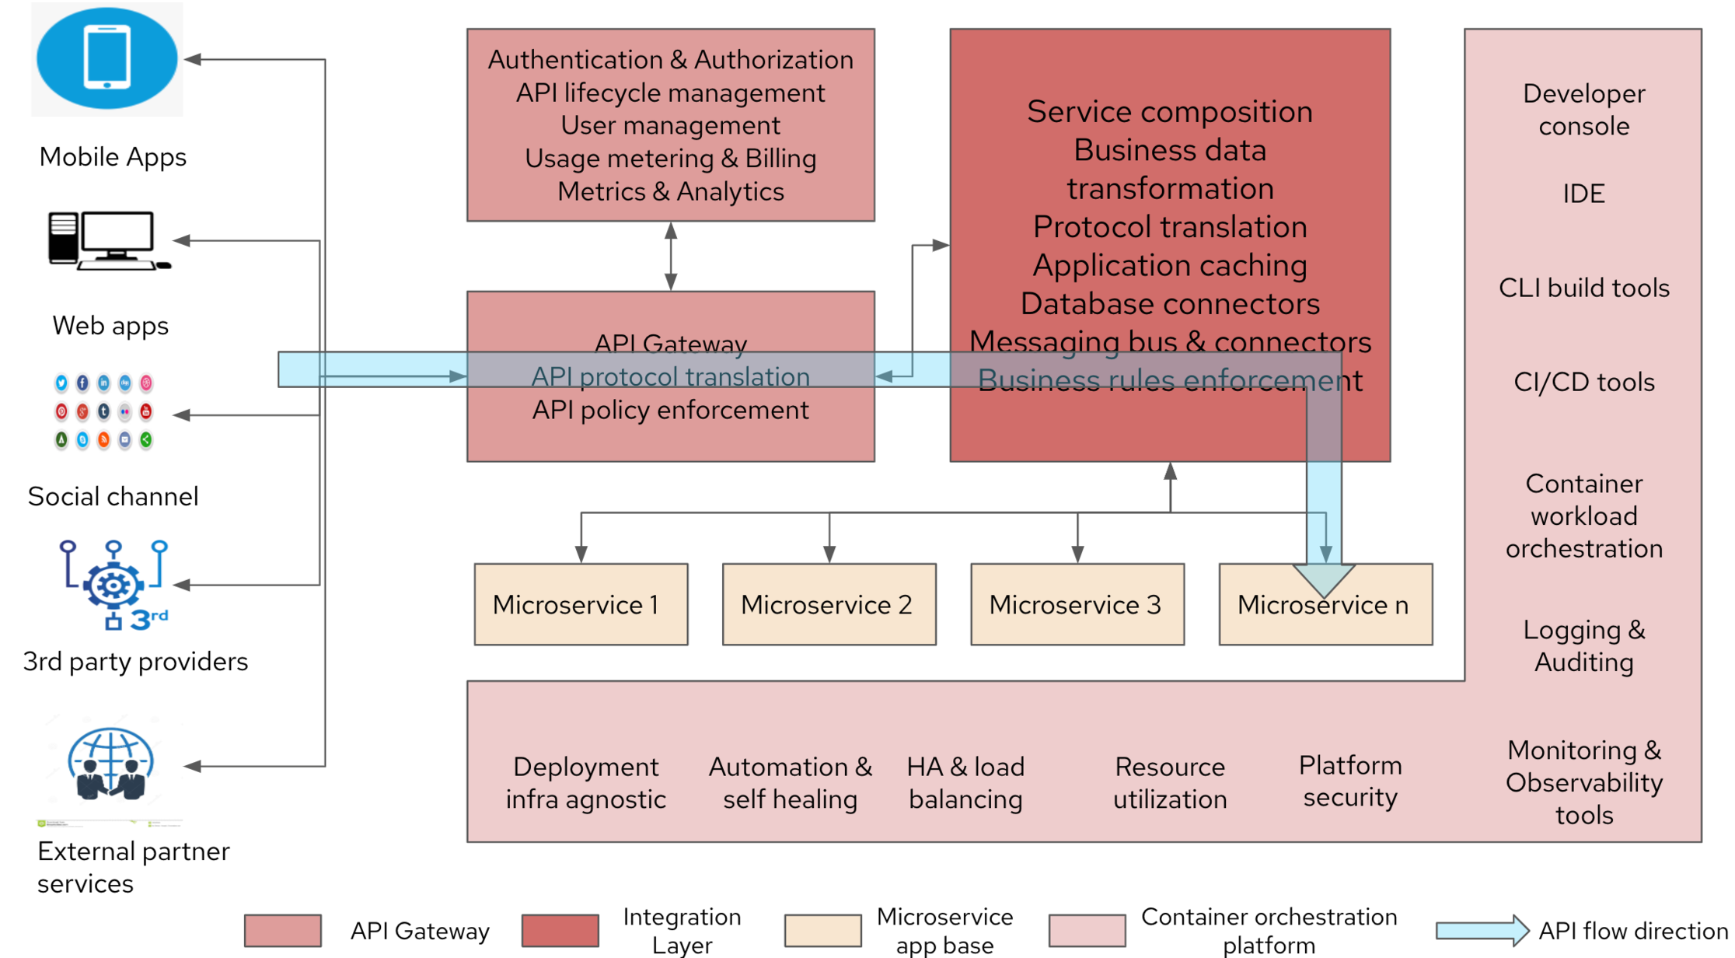

Slide 7



Slide 8
Azure Kubernetes Service (AKS) for hosting containerized microservices, experience APIs, and integration APIs built on Spring Boot.
Angular App and Drupal CMS on AKS for web applications and content management.
Polyglot persistence using Azure SQL Database (PostgreSQL) / Azure Cosmos DB / Azure Blob Storage for flexible and scalable data storage solutions.
Azure API Management for securing, publishing, and analyzing APIs.
API Management Gateway for internal and external services integration.
Azure Notification Hubs for push notifications.
Azure Service Bus or Event Grid for messaging and integration between microservices.
Azure Cache for Redis for caching data and improving performance.
Azure Key Vault for secrets and key management.
Android MPOS SDK integration with Ezetap, Yes Bank.
Web and mobile app integration with Azure Application Insights for performance monitoring and analytics, and with third-party services like Twitter, Facebook, YouTube.
Azure Monitor and Azure Log Analytics (part of Azure Monitor) for application performance management (APM) and cloud resource monitoring.

Slide 9
Overview of Unique Bank
Global Presence: Operates across 28 markets, with a strong base in APAC and EMEA regions.
Strategic Regional Focus: Strategically positioned to capitalize shifting focus on emerging markets Asia and ME
Digital Transformation Leader: Recognized for being forefront of digital transformation in finance sector
Commitment to Sustainability: Actively support social entrepreneur to develop innovative solution for sustainability challenges.

Slide 10
Current State Analysis: Challenges & Business Goal
Current system is legacy-based and built on off-the-shelf products
Customers are happy with the current system, but new features and modern technology are necessary for competitiveness
Goals:
Build a new best-in class Retail Internet Banking platform using the latest technologies
Custom software solution replacing the existing commercial product
Focus on delivering a rich user experience and Responsive design, scalable system, and modern navigation
Seamless migration process for existing users

Slide 11
Solution Value Proposition:
Business
Gain Competitive advantage
Reliable Data driven insights
Trusted partner to support future roadmap
Technology
Legacy infrastructure with limited flexibility
Limited standardization
Need for new technology adaption
Portal and infra to be able to Scaleup
User
Need for Integrated User Experience for Stakeholders while accessing Web portals and mobile application
Operation
Cost efficiency challenges
Need for SLA with measures
Need for deduped data to enable reporting
Who, When, Where, What
Cognizant as your Trusted Partner to support your envisioned Transformational Roadmap
Implementing a Scalable state of the art Web -Portal, Mobile App with Chat Bot hosted in VPC
Implementation to conclude in 12Months and support to run in parallel for 4Y & 9M
Having Integrated Tools across IT Infrastructure, ITSM, Network, Testing, DevSecOps & Monitoring & management
Streamlined Governance, with Ownership and accountability during the Support Phase
Enrich business user experience while accessing Web Portal & Mobile App with No disruption to existing services
How
Agile & Flexible Infrastructure
Setup VPC in Google Cloud for DEV. Test, Prod & DR with Active - Active DC & DR replication
Monitor and Manage Infrastructure & Apps
Setup of ITSM tool and integrate with Helpdesk (HD)
Setup ServiceDesk & Helpdesk to support Infra & Applications
Enhance User Experience
Design and Implement a Web portal and Mobile App using suggested front & backend technologies for the use cases aligned to Motor insurance LoB
The portal enables Chatbot with Live Agent functionality through GCP native API Mgmt. services
Standardized Data & Improvise Reports
Standardize and Migrate historical data and content to GCP native Data store
Setup Google Analytics Suite to support Web Analytics needs
Stable & Secure Operations
Co-creation of SLA's. OLA's & KPI
Simplified Operating model & Governance with Ownership and accountability
24x7 HD & SD for Web-portal & Mobile App support catering to L1/2/3 support
Managed services for Infra & Apps for 4Y& 3M
starting from Phase 1 - Go-LIVE

Slide 12
Current Mode of Operation (CMO)
Infrastructure built on Legacy Architecture and Standards leading to limited flexibility
Stability issues due to traffic and transactions
Challenges to integrate with external systems
Security & Compliance to adhere to current Global standards
Limited electronic presence and non-persona based web-portal & mobile apps
Interoperability between devices
Initiate
Due diligence & Kick off
Stakeholder Identification
Detailed system study
Validation of list of activities, scope, duration for each activity & guiding principles
Schedule workshop and review & examine AS-IS process documentation
Submission of detailed project plan, deployment plan document and Change Management document
Ideate
Conduct stakeholder Interviews
Reaffirm Business & functional requirements
Analyze proposed architecture against requirements
Detail SRS Document, USE cases and Activity diagram
Create HLD & LLD for the proposed architecture
Define key integrations points, system requirements and close architectural gaps
Establish
Setup VPC in Google Cloud for DEV, Test, Prod, & DR with Active -Active DC & DR replication
Setup Monitoring tools for Infra & Apps
Setup of ITSM and integrate with SD, HD, Monitoring tools and enable workflows
Setup API gateway & BPM tool to manage API's and workflows
Enable Network services to support Migration and implement Security for application
Enable
Develop the Wb portal using Angular, React, node js, for Motor LoB
Build Chatbot with Live agent functionality and integrated with Portal through API's Setup Google Analytics for Web Analytics reports and Migrate 8GB of Content & 500GB of historical Data to GCP native data store Establish 24x7 HD support and 8x7 SD support for L1/2/3 support for infra &
Future Mode of
Operation (FMO)
Agile & Flexible Infrastructure with 24x7 SD & HD support
Enhanced User Experience thru Portal and Mobile App built on Opensource with Chatbot & Live Agent interfaces
Standardized historical data to support Web Analytics & Business needs
Managed Services for Infra & Apps for 478 3M starting from Phase 1 - Go-LIVE

